Slide 1
Differentiable Programming for Data-driven Modeling, Optimization, and Control
Fourth Symposium on Machine Learning and Dynamical Systems
The Fields Institute, Toronto
Ján Drgoňa

Slide 2

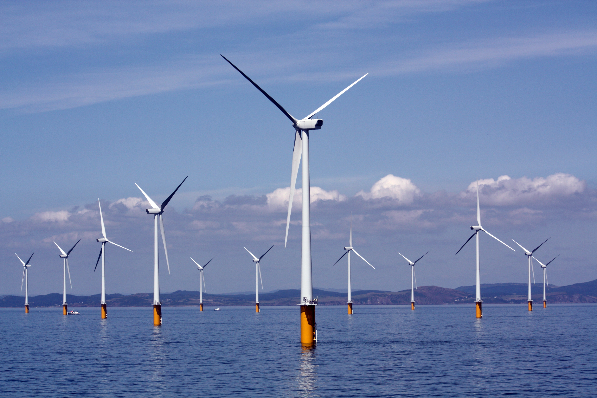
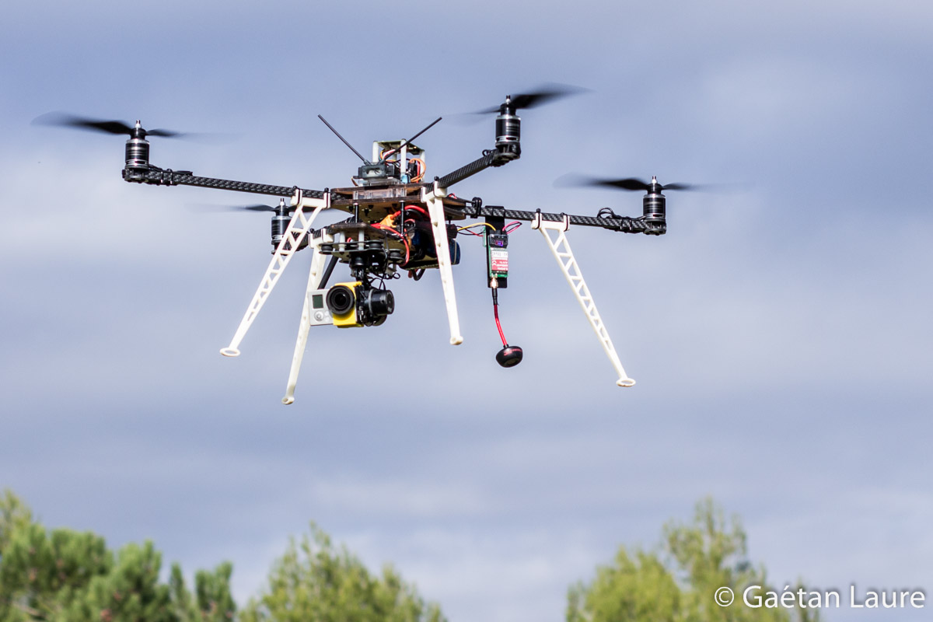
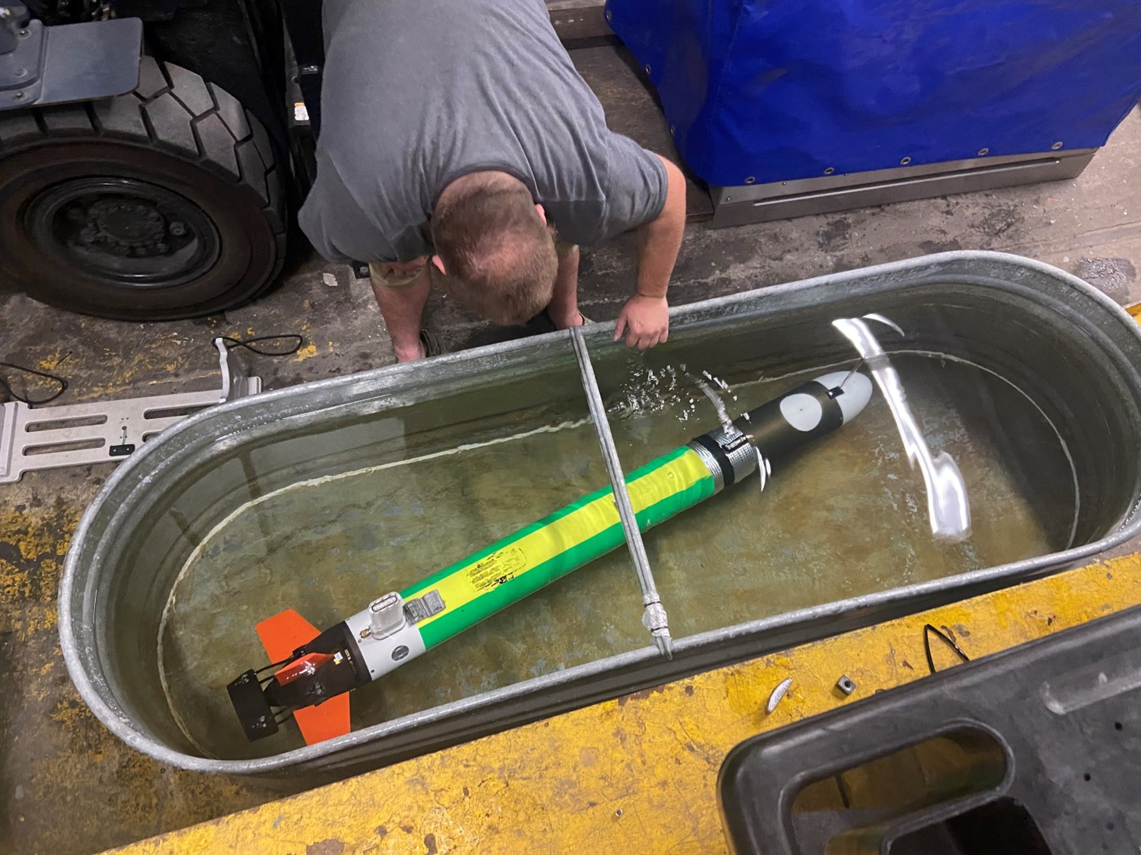
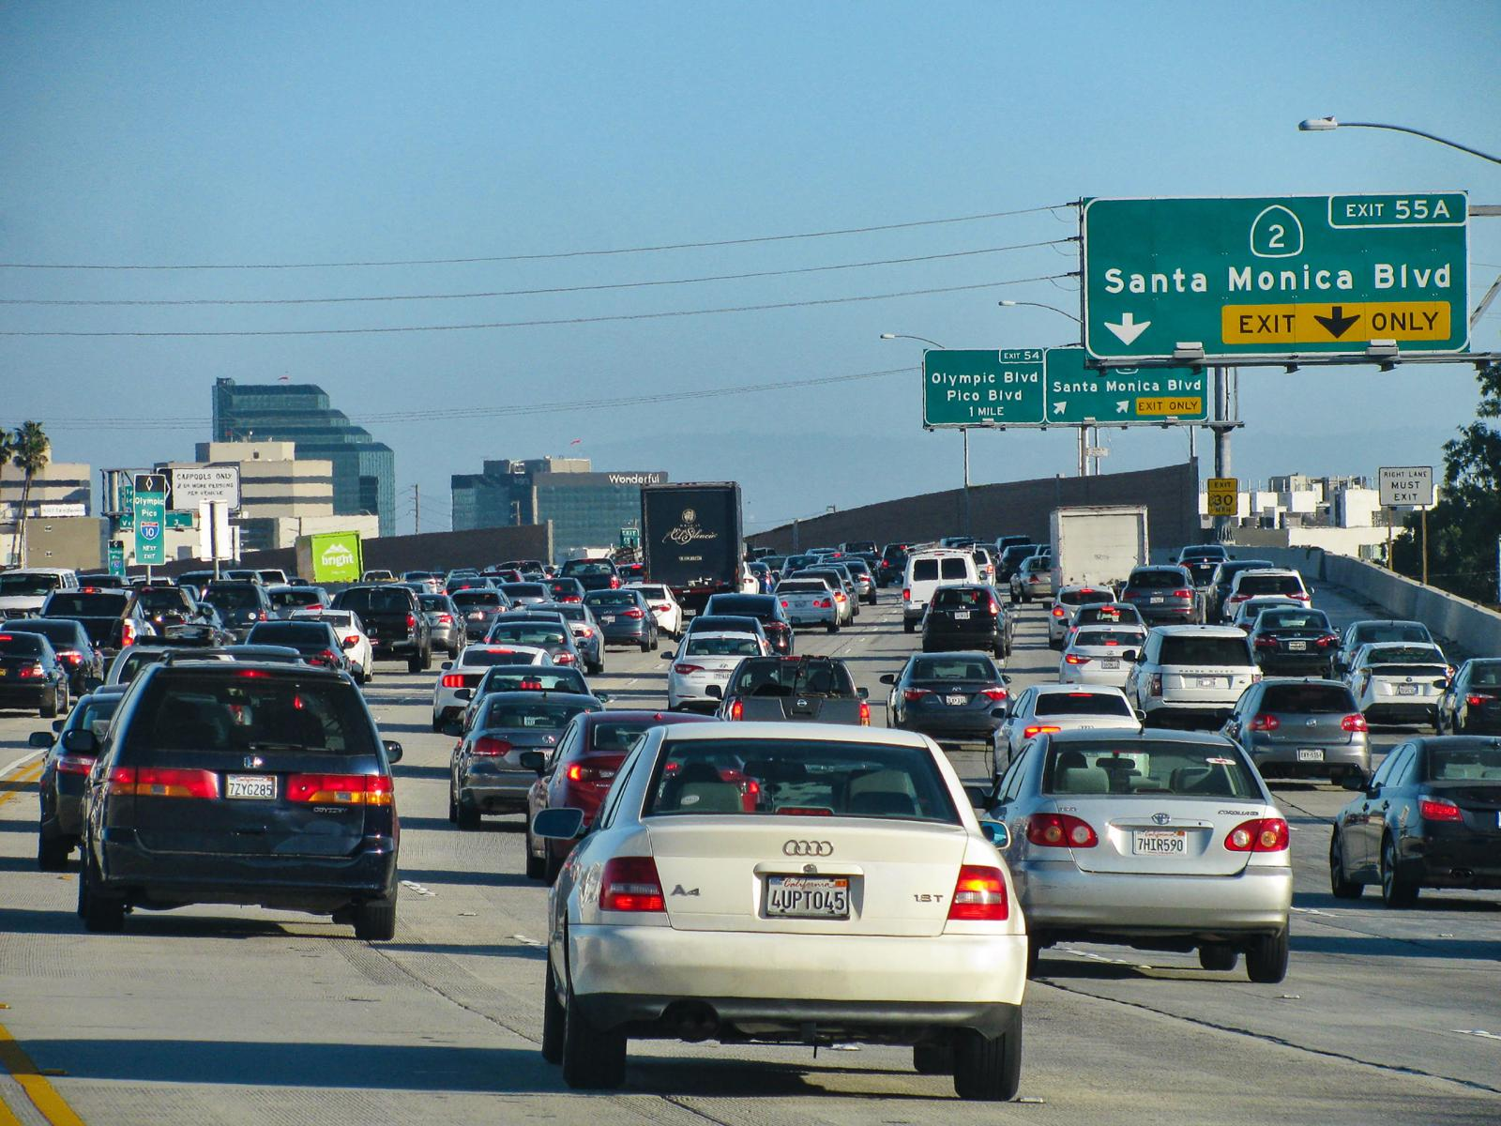
Motivation
Simulations are crucial for many areas of decision-making and scientific discovery
Need: Improve computational efficiency and scalability for heterogenous scientific simulations
Challenges:
Modeling and simulation of complex systems is hard
Optimal control and closed-loop decision-making for complex systems is hard-er
Scientific computing and machine learning tools are fragmented and not easily composable

Slide 3
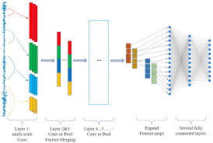
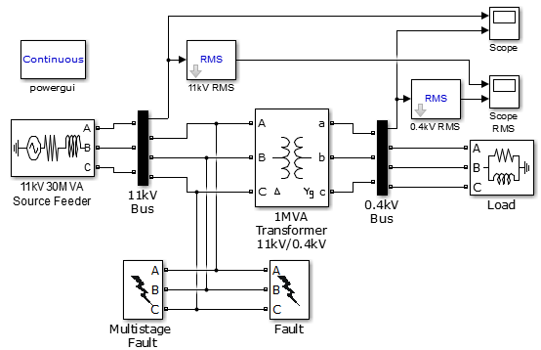
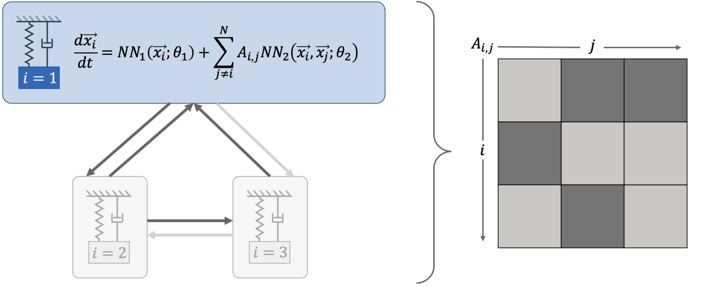
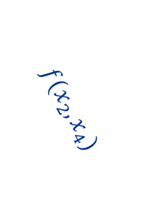
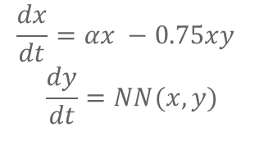

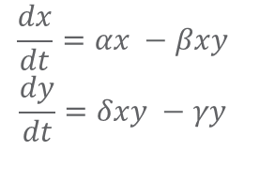
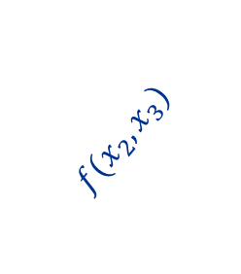
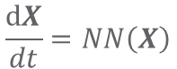
Challenge 1: Heterogenous Modeling Methods
White-box
Gray-box
Black Box
$$\frac{dx}{dt}=αx −βxy$$
$$\frac{dy}{dt}=δxy −γy$$
$$\frac{dx}{dt}=αx −0.75xy$$
$$\frac{dy}{dt}=NN(x,y)$$
$$\frac{dX}{dt}=NN\left(X\right)$$
More domain knowledge
Less domain knowledge
physics-based
networked neural ODEs
neural differential equations
state space models
physics priors
graph neural networks
3
$$f(x_{2},x_{3})$$
$$f(x_{2},x_{1})$$
1
2
$$f(x_{2},x_{4})$$
4

Slide 4

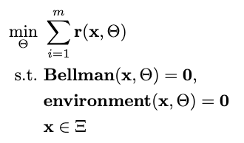

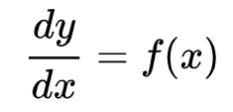

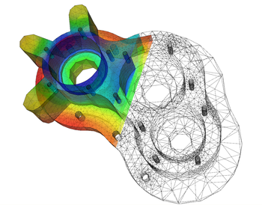
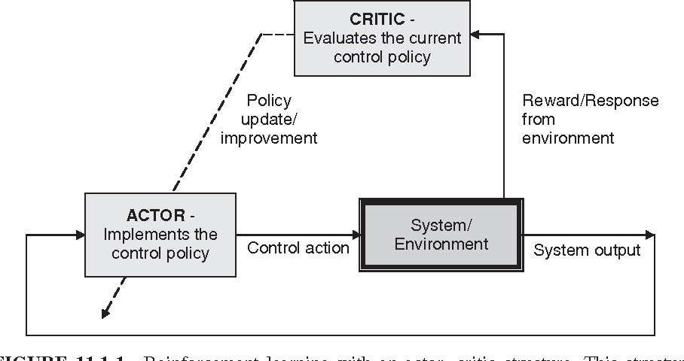

Challenge 2: Heterogenous Solution Methods
Constrained optimization
Differential equations
Supervised Learning
Reinforcement Learning
Requires prior knowledge of objective function and constraints
Requires prior knowledge of the physics to be modeled
Requires large labeled datasets
Requires environment model to sample
More domain knowledge
Less domain knowledge

Slide 5

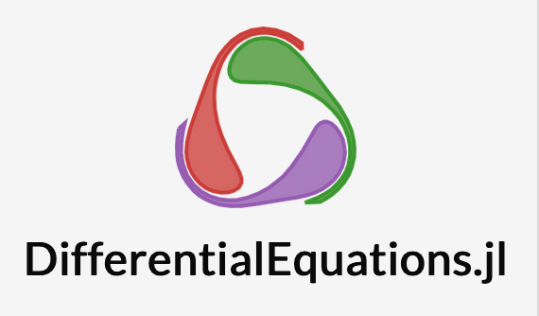


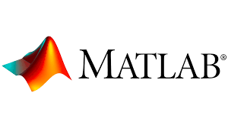
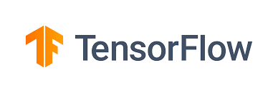



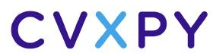


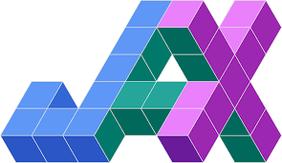



Challenge 3: Heterogenous Solution Tools
Constrained optimization
Differential Equations
Supervised Learning
Reinforcement Learning
More domain knowledge
Less domain knowledge

Slide 6
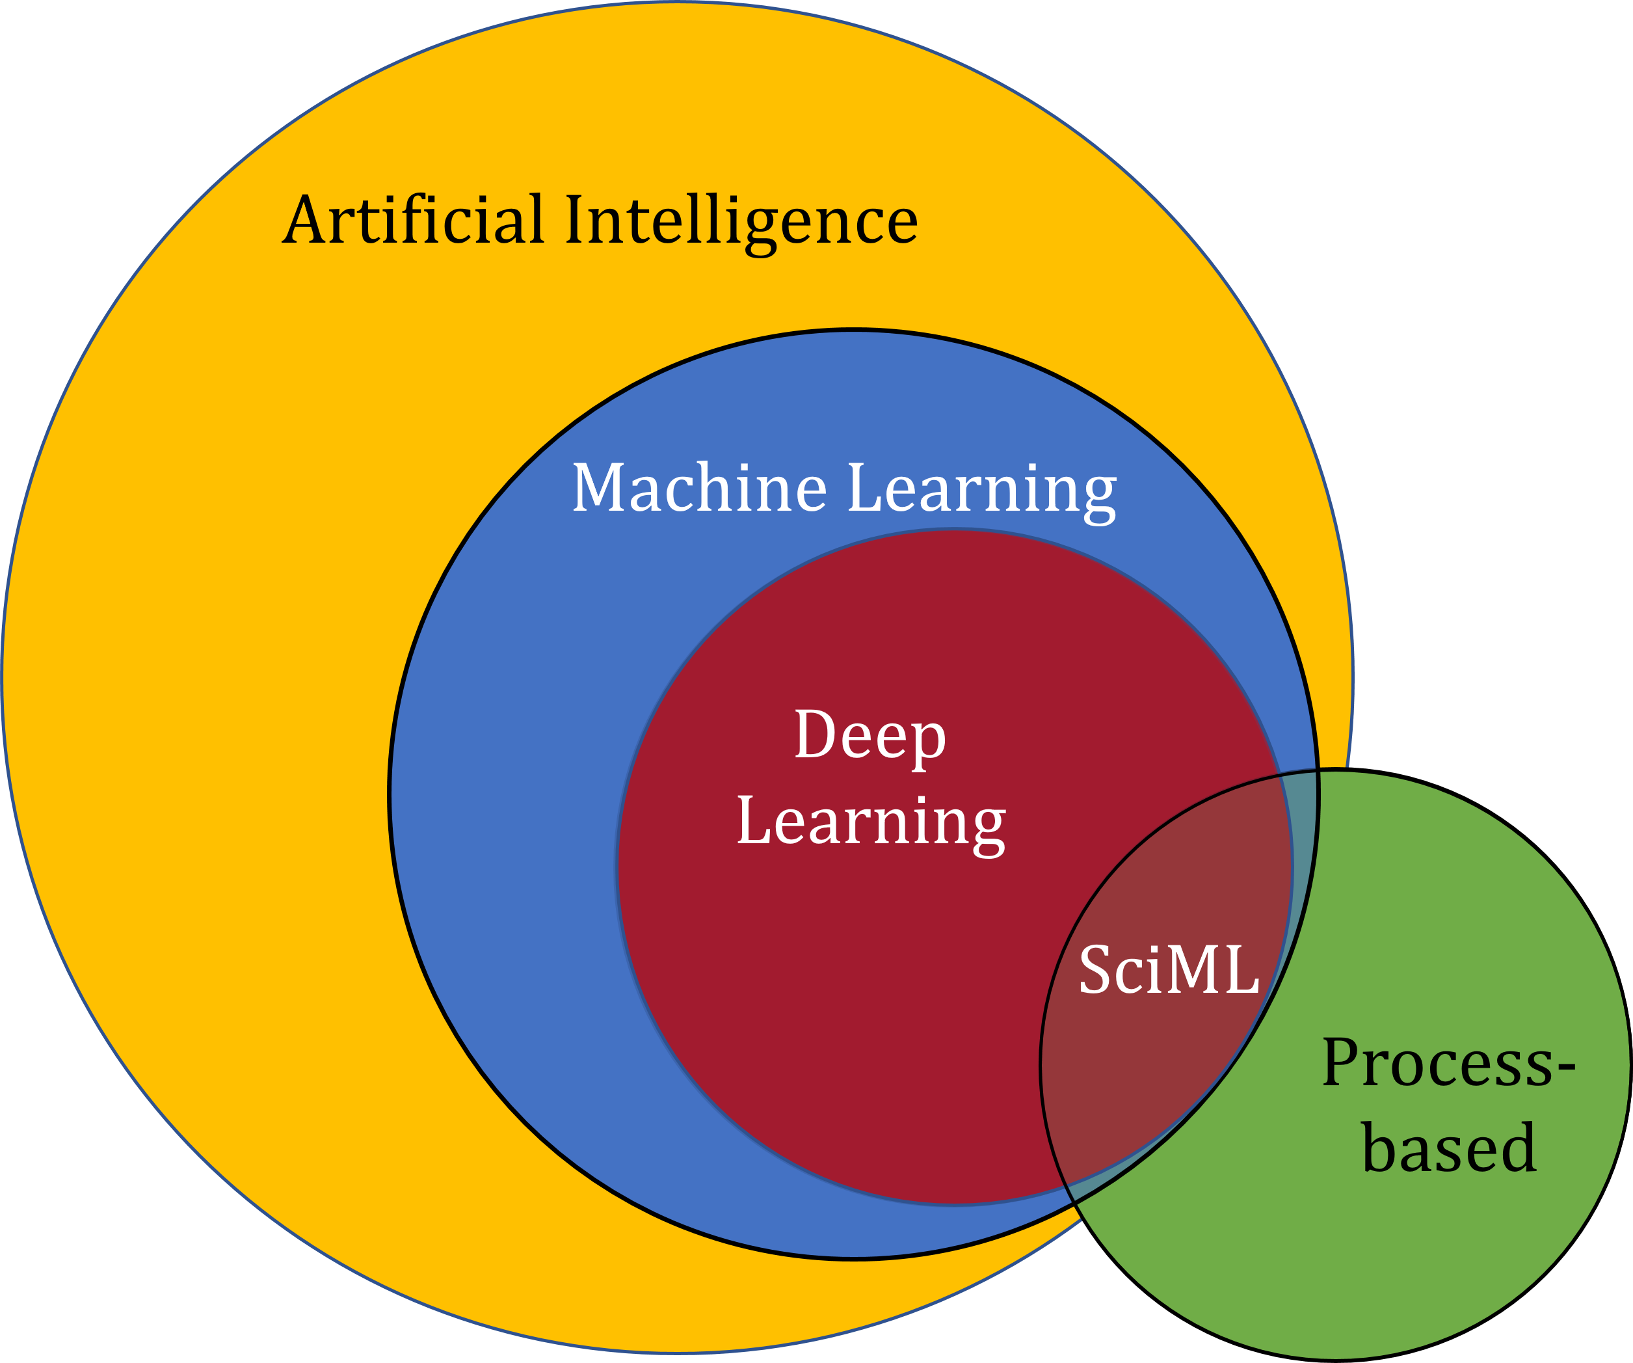
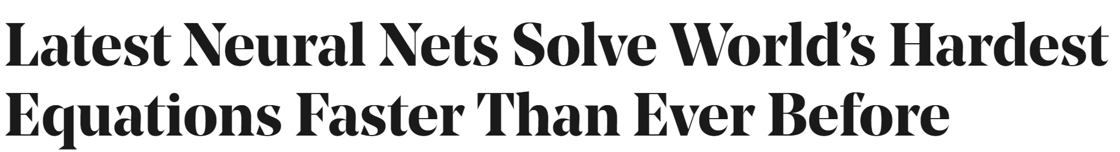
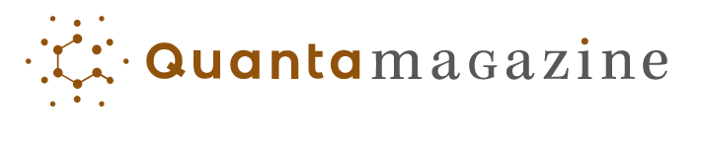
Scientific Machine Learning (SciML)
What?
SciML or Physics-Informed Machine learning (PIML) systematically integrates ML with models and algorithms developed in traditional scientific and engineering domains
Why?
Scientific applications are governed by fundamental principles and physical constraints
Purely data-driven “black box” ML methods cannot satisfy underlying physics
How?
Leverage automatic differentiation to enable learning for modeling, optimization, and control
Image source: https://sciml.wur.nl/reviews/sciml/sciml.html

Slide 7
Selected Scientific Machine Learning Literature
Differentiable Programming
M. Innes, et al., A Differentiable Programming System to Bridge Machine Learning and Scientific Computing, 2019
Learning to Solve (L2S)
M. Raissi, et al., Physics-informed neural networks: A deep learning framework for solving forward and inverse problems involving nonlinear partial differential equations, 2019
Learning to Optimize (L2O)
A. Agrawal, et al., Differentiable Convex Optimization Layers, 2019
P. Donti, et al., DC3: A learning method for optimization with hard constraints, 2021
J. Kotary, et al., End-to-End Constrained Optimization Learning: A Survey, 2021
Learning to Model (L2M)
B. Lusch, et al., Deep learning for universal linear embeddings of nonlinear dynamics, 2018
R. T. Q. Chen, et al., Neural Ordinary Differential Equations, 2019
C. Rackauckas, et al., Universal Differential Equations for Scientific Machine Learning, 2021
Learning to Control (L2C)
B. Amos, et al., Differentiable MPC for End-to-end Planning and Control, 2019
S. East, et al., Infinite-Horizon Differentiable Model Predictive Control, 2020
Y Qiao, et al., Scalable Differentiable Physics for Learning and Control, 2020

Slide 8
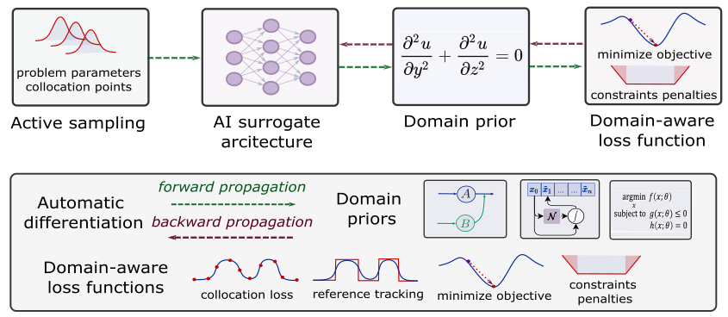
Can We Unify Different Scientific Machine Learning Methods in a Coherent Algorithmic Framework?
Sampling methods
Machine learning component
Domain inductive priors
Domain-aware loss functions

Slide 9

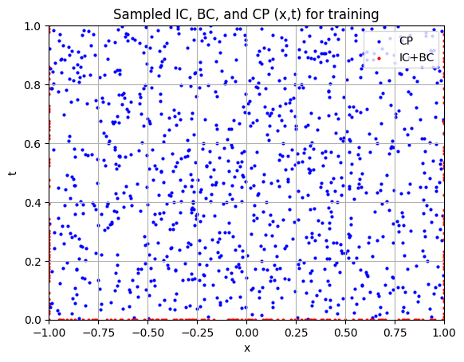
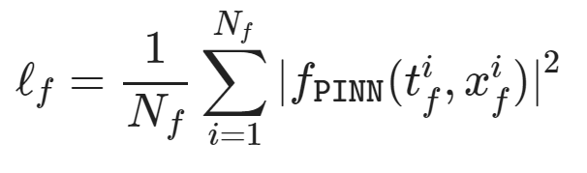
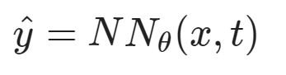
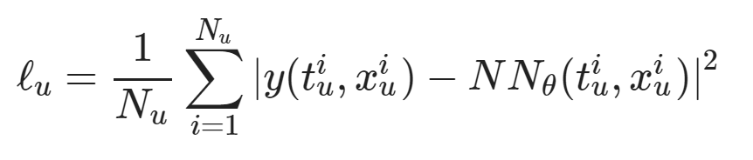
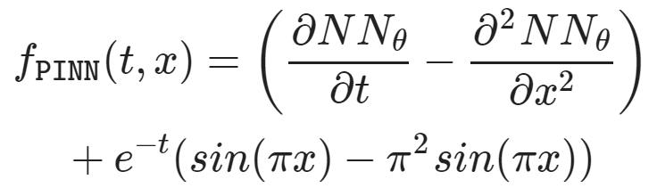
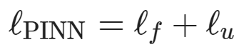
Learning to Solve Differential Equations with Physics-Informed Neural Networks (PINNs)
Dataset: collocation points in the spatio-temporal coordinates.
Architecture: PDE equations solved with neural network via automatic differentiation.
Loss function: minimizing PDE equation, initial and boundary condition residuals.
https://github.com/pnnl/neuromancer/blob/master/examples/PDEs/Part_2_PINN_BurgersEquation.ipynb
M. Raissi, et al., Physics-informed neural networks: A deep learning framework for solving forward and inverse problems involving nonlinear partial differential equations, Journal of Computational Physics, 2019

Slide 10
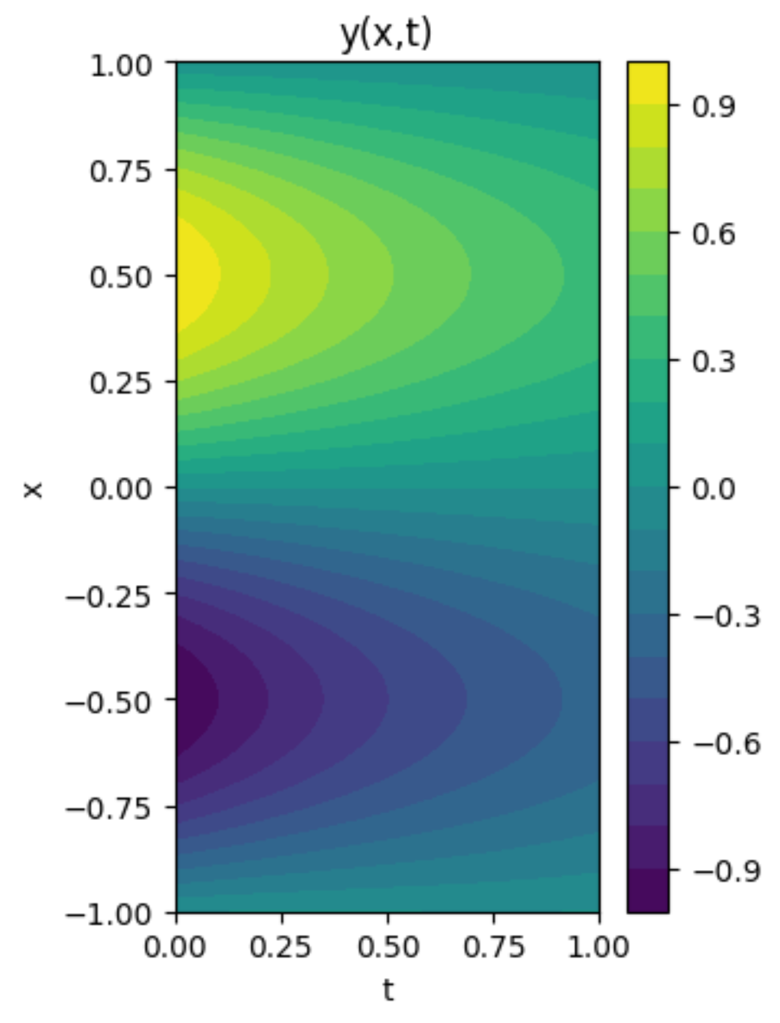
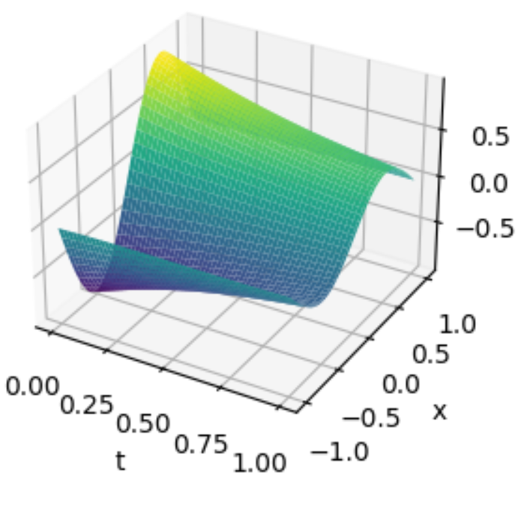
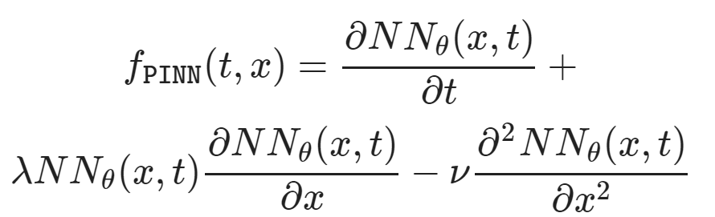
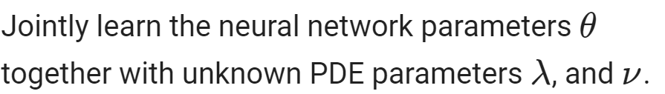
Learning to Solve Differential Equations with Physics-Informed Neural Networks (PINNs)
Training neural networks as PDE solutions
Parameter estimation from data (inverse modeling)

Slide 11
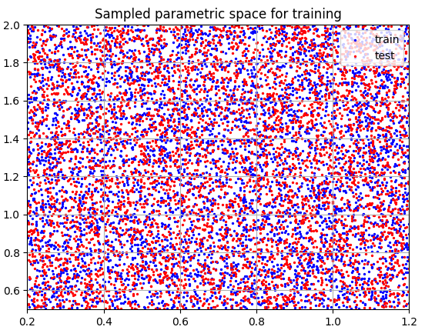
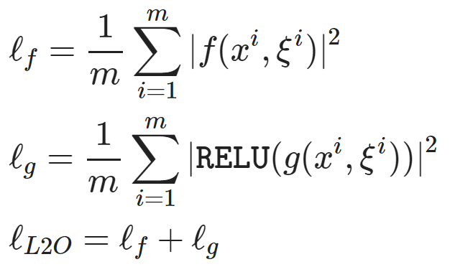
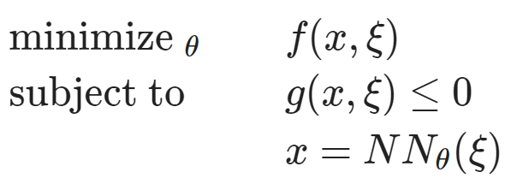
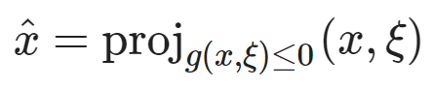
Learning to Optimize (L2O) with Constraints
Dataset: collocation points in the parametric space.
Architecture: differentiable optimization solver with neural network surrogate.
Loss function: minimizing objective function and constraints penalties.
https://github.com/pnnl/neuromancer/blob/master/examples/parametric_programming/Part_1_basics.ipynb
A. Agrawal, et al., Differentiable Convex Optimization Layers, 2019
P. Donti, et al., DC3: A learning method for optimization with hard constraints, 2021

Slide 12
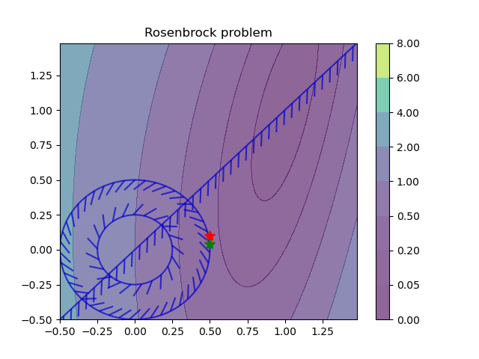
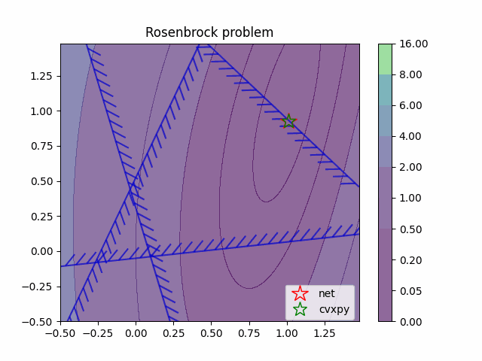
Learning to Optimize (L2O) with Constraints
Training neural networks as parametric solutions
Feasibility restoration with implicit layers

Slide 13
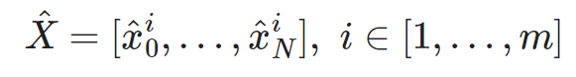
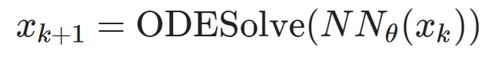
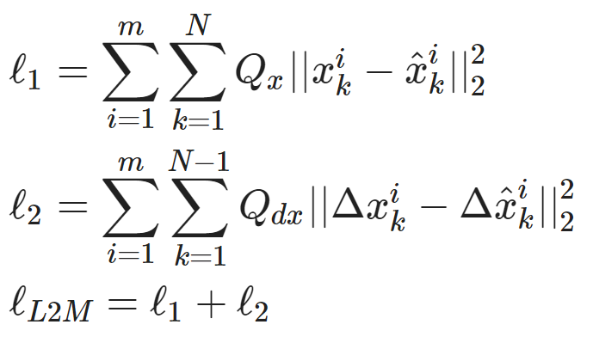
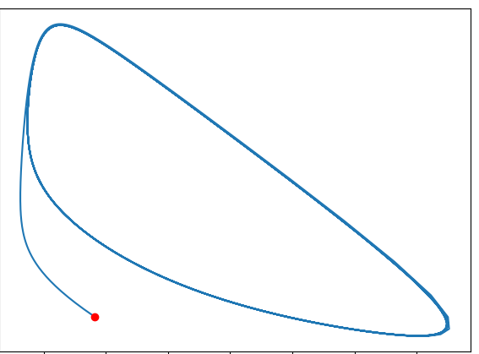
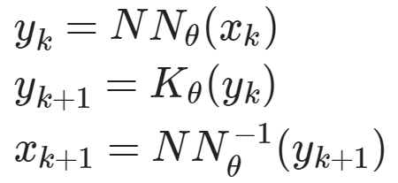
Learning to Model (L2M) with Neural Operators
Dataset: time-series of states, inputs, and disturbances tuples.
Architecture: differentiable ODE solver with neural network model.
Loss function: trajectory matching, regularizations, and constraints penalties.
Architecture: Koopman operator with neural network basis functions.
https://github.com/pnnl/neuromancer/blob/master/examples/ODEs/Part_1_NODE.ipynb
R. T. Q. Chen, et al., Neural Ordinary Differential Equations, 2019
B. Lusch, et al., Deep learning for universal linear embeddings of nonlinear dynamics, 2018

Slide 14
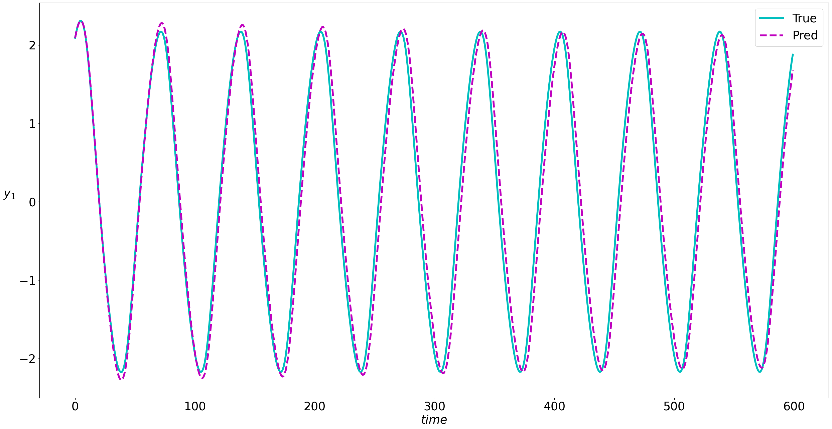
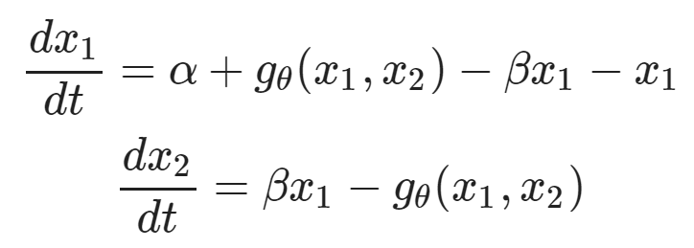
Learning to Model (L2M) with Neural Operators
Neural models for nonlinear system identification
Gray-box parameter estimation
C. Rackauckas, et al., Universal Differential Equations for Scientific Machine Learning, 2021

Slide 15
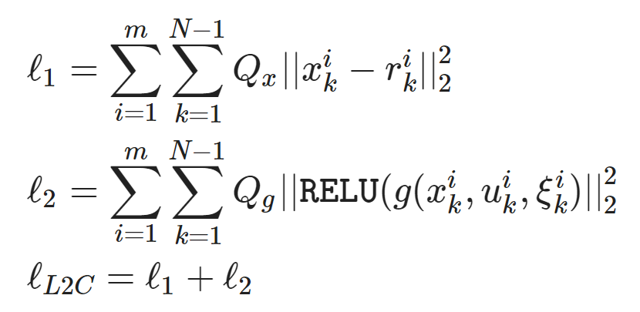
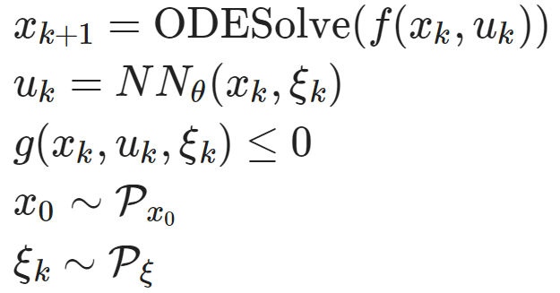
Learning to Control (L2C) with Differentiable System Models
Dataset: collocation points in the control parametric space.
Architecture: differentiable model with neural network control policy.
Loss function: reference tracking, constraints and terminal penalties.
https://github.com/pnnl/neuromancer/blob/master/examples/control/Part_3_ref_tracking_ODE.ipynb
Jan Drgona, et al., Differentiable Predictive Control: An MPC Alternative for Unknown Nonlinear Systems using Constrained Deep Learning, Journal of Process Control, 2022

Slide 16



Learning to Control (L2C) with Differentiable System Models
Trajectory optimization for dynamical systems
Learning stabilizing controllers

Slide 17
Towards Unified Scientific Machine Learning Framework
Karniadakis, G.E., Kevrekidis, I.G., Lu, L. et al. Physics-informed machine learning. Nat Rev Phys 3, 2021.
Thiyagalingam, J., Shankar, M., Fox, G. et al. Scientific machine learning benchmarks. Nature Reviews Physics 4, 413–420, 2022.
Nghiem T., Drgona J., et al. Physics-Informed Machine Learning for Modeling and Control of Dynamical Systems, ACC, 2023.

Slide 18





NeuroMANCER Scientific Machine Learning Library
1. Mathematical formulation
3. Problem graph
map
2. Python code interface
4. Results
import neuromancer as nm
p = nm.variable(‘p’)
x = nm.variable(‘x’)
y = nm.variable('y’)
obj = ((1-x)**2 + p*(y-x**2)**2).minimize(weight=1.0, name='obj’) c1 = (p/2)**2 <= x**2 + y**2
c2 = x**2 + y**2 <= p**2
c3 = x >= y net = nm.MLP(insize=2, outsize=2, hsizes=[80]*4) map = nm.Node(net, input_keys=['p’], output_keys=[‘x’,‘y’])
loss = nm.PenaltyLoss([obj], [c1, c2, c3]) problem = nm.Problem([map], loss)
optimizer = torch.optim.AdamW(problem.parameters()) trainer = nm.Trainer(problem,data,optimizer)
best_model = trainer.train()

Slide 19



Summary
NeuroMANCER open-source scientific machine learning (SciML) library integrating deep learning, constrained optimization, physics-based modeling, and control in a coherent framework
Learning to optimize (L2O)
Learning to control (L2C)
Learning to model (L2M)
Learning to solve (L2S)
github.com/pnnl/neuromancer
www.youtube.com/@neuromancer_SciML
drgona.github.io

Slide 20






Acknowledgements
Core Development Team
Ján Drgoňa
Diff Predictive Control
Aaron Tuor
Deep Learning
Madelyn Shapiro
Deep Learning
Rahul Birmiwal
Software Development
Bruno Jacob
Dynamical Systems
Draguna Vrabie
Predictive Control

Slide 21

Hiring!
Starting a new group at the Department of Civil & Systems Engineering at Johns Hopkins University
Multiple PhD and postdoc opportunities
Starting January 2025
Focus on Scientific Machine Learning for dynamics, optimization, and control
Applications in energy systems
drgona.github.io

